Slide 1
Distributed Generation Technologies for Commercial and Industrial Applications:
Today’s Options and Potential Advancements
Energy Information Administration
NEMS/Annual Energy Outlook Conference
March 27, 2001
Paul Bautista

Slide 2
Presentation Outline
DG Technologies
DG Applications
DG Markets
DG Future Market Outlook

Slide 3

The New Energy Market
Customer Choice in a competitive climate
Regulatory Change facilitates competition
Product Portfolio enables customer & provider choices
The basis of the new business is providing value with customer-focused solutions

Slide 4
DG Technology
Reciprocating Engines (30 - 6,000 kW)
Industrial Gas Turbines (500 - 20,000 kW)
Microturbines (25 - 300 kW)
Fuel Cells (3 - 3,000 kW)
Renewables - photovoltaics, wind (1-1,000 kW)
Notes:
DG applications can potentially utilize a wide range of distributed power generation technologies. Commercial technologies such as reciprocating engines and small combustion turbines already are used in a variety of applications from emergency power to combined heat and power. Emerging technologies such as fuel cells, microturbines, and photovoltaics, and wind systems will provide additional options for distributed power generation.

Slide 5
Technology Options
Status
Size
Efficiency
Installed
O&M Costs
(%)
Costs ($/kW)
($/kWh)
Reciprocating
Commercial
30 kW -
30 - 38
500 - 1400
0.007-0.02
Engine
6 MW
Gas
Commercial
500 kW -
25 - 40
600 -900
0.003-0.008
Turbine
20 MW
Microturbines
Commercial
25 kW -
20 - 30
600 - 1000
0.003-0.01
300 kW
Fuel Cells
1996 - 2010
3kW -
36 - 60+
1900 - 3500
0.005-0.010
3MW

Slide 6
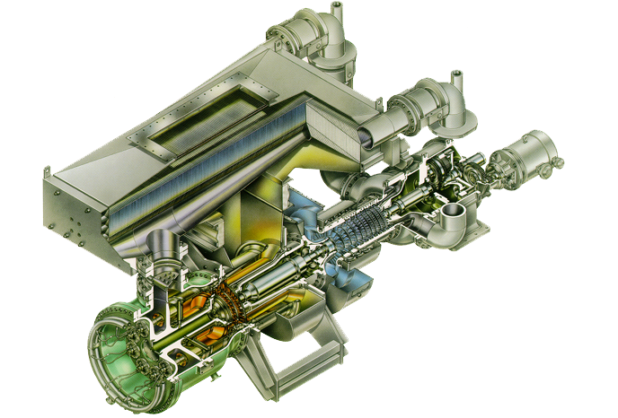
Small Gas Turbines
Size range: 500 - 20,000 kW
Electric efficiency (25-40%)

Slide 7
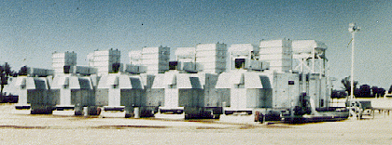
Gas Turbines
Small turbines (1-30 MW) established technology for many power and direct drive applications
Fuel flexible but economics and emissions favor natural gas
Good for CHP applications requiring high quality steam in industrial and large commercial applications
Notes:
Combustion turbiines range in size from under 1 MW to utility-sized models ranging in size from 50 - 300 MW. Small turbines (1-30 MW) represent an established technology for many power and direct drive applications in industry, large commercial and institutional facilities such as universities, and in oil and gas production and transportation. CTs are fuel flexible but economics and emissions favor the use of natural gas. They are good for CHP applications requiring high quality steam in industrial and large commercial applications as a simple cycle turbine exhaust is in the range of 900-1000º F. This exhaust heat can be captured by a heat recovery steam generator (HRSG) capabile of providing high pressure steam for industrial process use, or for providing steam and chilled water for large facilities or for a collection of smaller facilities (district heating and cooling.)

Slide 8
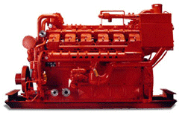
Reciprocating Engines
Size Range: 30 - 6,000 kW
Electric efficiency: 30 - 38%

Slide 9
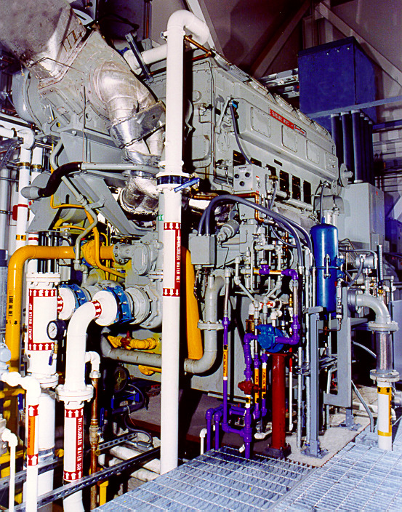
Reciprocating Engines
Established technology, most common prime mover in the world, distribution channels in place
Gas-fired spark ignition engines appropriate for CHP, peak shaving, and direct drives less than 10 MW
Diesel engines most common for standby, emergency, and remote applications
Notes:
Reciprocating engines are currently the most common type of distributed generation. “Recips” represent an established technology, and the most common prime mover in the world. There are many competitive manufacturers and distribution channels are in place. Diesel engines are commonly used for standby, emergency, and remote applications. Gas-fired spark ignition engines appropriate for CHP, peak shaving, and direct drives less than 10 MW.

Slide 10
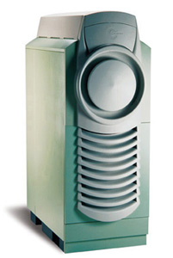
Microturbines
Size range: 25 - 300 kW
Electric efficiency: 20 - 30%

Slide 11
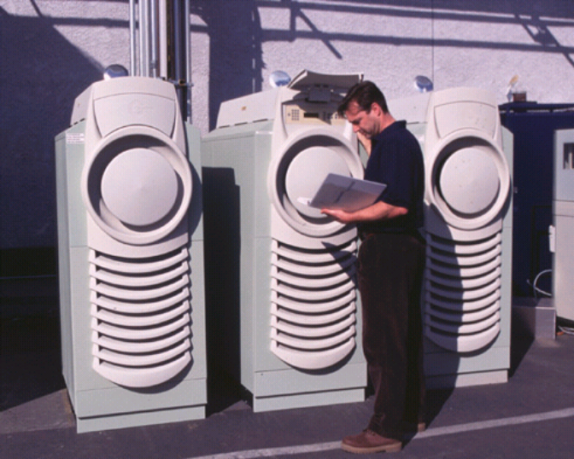
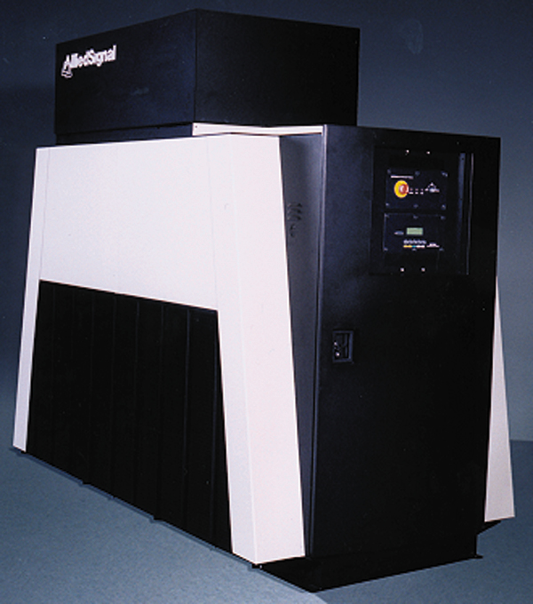
Microturbines
Emerging technology for commercial rollout occurring now
Simple designs with few moving parts
Distribution, marketing, and service opportunities still exist
Good for both small CHP, power only, peaking, and even standby
Notes:
Microturbines or turbogenerators are very small combustion turbines with outputs of 30 kW to 200 kW. At least two companies have reached the stage of initial commercialization, and several other companies are developing systems with plans for near-term product introduction. Turbogenerator technology has evolved from automotive and truck turbochargers, auxiliary power units for airplanes or tanks, and small jet engines used for pilotless military aircraft. Recent development of these microturbines has been focused on this technology as the prime mover for hybrid electric vehicles and as a stationary power source for the DG market. In most configurations, the turbine shaft spinning at up to 100,000 rpm drives a high speed generator. This high frequency output is first rectified and then converted to 60 Hz (or 50 Hz). The systems are capable of producing power at around 25-30% efficiency by employing a recuperator that transfers heat energy from the exhaust stream back into the incoming air stream. The systems are air-cooled and some even use air bearings, thereby eliminating both water and oil systems. Low emission combustion systems are being demonstrated that provide emissions performance comparable to larger CTs.
Turbogenerators are appropriatedly sized for commercial buildings or light industrial markets for CHP or power-only applications.

Slide 12
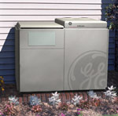
Fuel Cells
Size range: 3 - 3,000 kW
Electric efficiency: 40-70%
Residential units promised for 2003
Emission controls - Exempt status

Slide 13
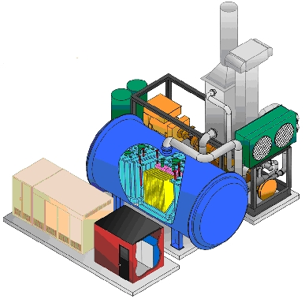
Fuel Cells
Electrochemical power production with a space-age heritage -- inherently efficient and clean
PAFC in early market applications -- many with economic subsidies
Other technologies to emerge in the next 5 years -- market opportunities exist
Notes:
Fuel cells represent a class of technologies that produce power from electrochemical reactions like a battery that is fed with a continuous flow of fuel rather than with stored chemicals. Like microturbines, there is interest in both the stationary and transportation markets. Phosphoric acid fuel cells are the only type of fuel cell that is commercially available today. They are manufactured by ONSI, a subsidiary of United Technologies, and about 200 units have been installed to date, most of them with the help of government provided incentive payments to bring down the high first cost ($4,500/kW) of the units. Financial and industry analysts do not see this technology as having mass market application, like microturbines. Rather, this generation of fuel cells is seen as a niche product for special applications: military, sensitive environmental areas, and high power quality applications.
There is considerable interest in the mass market potential of several new fuel cell developments including proton exhange membrane (PEM) (Ballard, Plug Power, Avista Labs), solid oxide fuel cells (SOFC) (Siemens Westinghouse, Global Thermoelectric) and molten carbonate (Fuel Cell Energy). While there have been some demonstration projects, none of these technologies have reached commercialization. Of the three, PEM technology is targeted at virtually the same size and markets as microturbine technology.

Slide 14
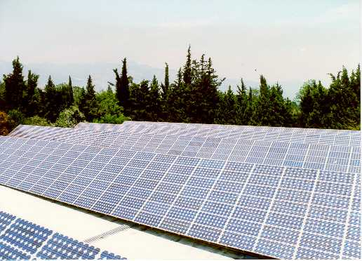
Photovoltaics
Technology is available for commercial application
Costs are high, Federal and State subsidies are available
High costs limit applications to niche markets -- remote areas and environmentally sensitive sites
Notes:
Photovoltaic power cells use solar energy to produce electricity by interaction of light’s photons and electrons within a semiconductor. Cells are interconnected in a module as a flat plate or concentrator system. Flat plates require large surface area, but can use both direct and indirect light. Concentrator requires direct sunlight, best in desert locations. Both types of systems can utilize sun tracking systems. PV systems require a power conditioner (DC to AC Inverter).
Photovoltaic power is modular and can be sited wherever the sun shines. These systems have been commercially demonstrated in extremely sensitive environmental areas or for remote (grid-isolated) applications. High costs make these systems a niche technology that is able to compete more on the basis of environmental benefits than on economics.

Slide 15
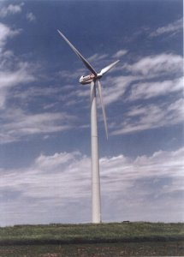
Wind Power
Size range: 50-1,000 kW
Start-up time: n/a
Commercially available
Visual, noise and wildlife impacts
Notes:
Wind is a form of solar energy caused by uneven heating of earth by the sun. Wind speeds of greater than 12 mph are required to generate power. Power capacity is proportional to the cube of wind speed. There are several types of systems with both horizontal and vertical blade systems (vertical shown.) A gear box is required to transfer power from the low speed blades to the high speed generator. Power control is achieved with variable pitch blades, or fixed position with stall design.
Cost and performance for these systems are improving, but typically require some form of subsidy to be competitive.
Wind power is a renewable form of energy with small outputs typical of other DG technologies. However, the requirements of siting, generally place wind systems in remote areas known for steady wind. Such areas do not provide the location benefits of other DG systems.

Slide 16

DG Applications
CHP
Standby
Peakshaving
Grid Support
Power Quality
Landfill and Biomass

Slide 17

Combined Heat and Power
13.5 Turbine-driven CHP at Rutgers University
Notes:
High thermal use customers such as process industries, hospitals, health clubs, laundries, etc. can meet their baseload or onpeak needs for electricity while meeting their thermal requirements with the waste heat from the DG system. In the smaller size range, fast food, restaurants, health clubs, small hotels and medical facilities have power needs in the 30-250 kW range and steady demand for thermal energy. CHP penetration levels are very high in large process industries, but significant market potential exists in smaller markets. These systems often require complicated financial arrangements and site engineering that add costs particularly for small capacity systems. Heat recovery equipment is required as are grid paralleling and protection hardware. High efficiency and low emissions are important to this market application. CHP also provides social benefits such as lower overall emissions, reduced contribution to global warming, and energy conservation. This market has declined in recent years as customers anticipate lower prices from restructured power markets - an expectation that may be tempered by the recent crisis in California. The long-term outlook is good as new technology becomes available and energy service providers increase marketing effort on this sector.
The Busch Cogeneration plant, shown, is a 13.5 MW CHP system that has been operating at Rutgers University since 1995. 3 Solar Taurus 4.5 MW dual-fuel turbines with water injection for NOx control provide power. High temperature hot water is produced for use in heating, localized steam generation, and absorption cooling.

Slide 18
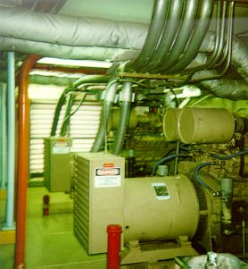
Standby Power
Provide support for critical systems during a power outage
Required by hospitals and some other critical life and safety applications
Also used by customers with very high outage costs
Two 450 kW diesel gen-sets shown here in the mechanical room of an Albuquerque hospital
Notes:
Standby power is an existing, mature market segment. Mostly consisting of diesel engine gen-sets, this “silent iron” is often left out of the discussion on DG applications as it is not connected to the grid and only operates in the event of a power outage. This market represents 80-90% of the total current engine market in North America with a generating capacity of 2000-3200 MW/year.
Standby power systems are required by fire and safety codes hospitals, elevator loads, andwater pumping. Standby is an economic choice for for customers with high outage costs like telecommunications, retail, process industries. Electric restructuring has resulted in a perception of more frequent outages and vulnerability to price spikes that can be avoided through standby power equipment. This application requires low cost, bare bones installation, with black start, and grid isolated operation. Efficiency, emissions, and variable maintenance costs are not important. Low-cost diesel generators dominate this market.

Slide 19
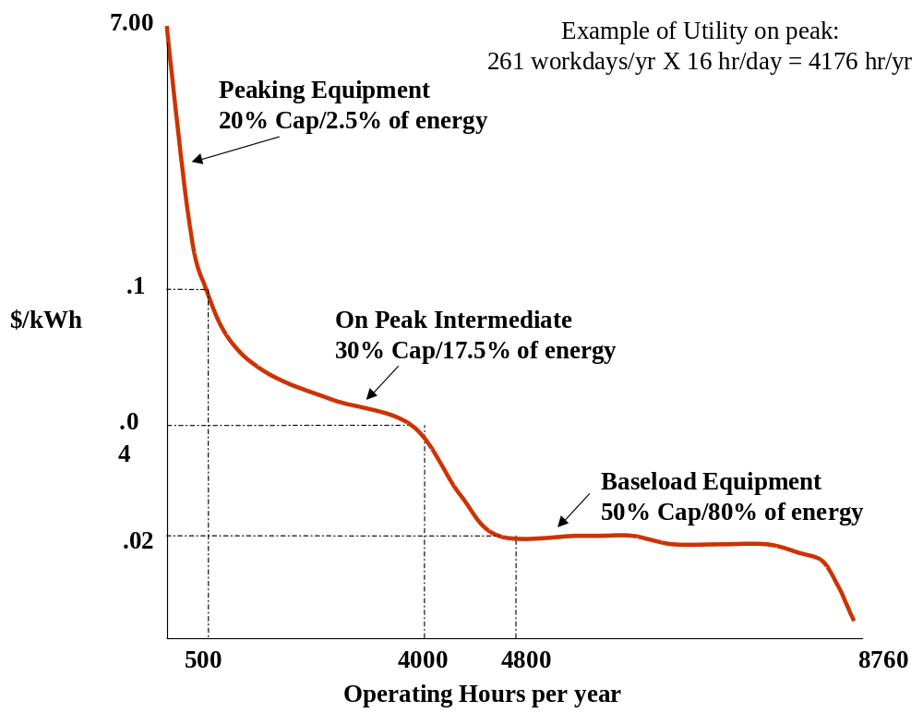
Peak Shaving
Notes:
Power during peak periods is expensive both on existing rate schedules, but it is also expensive in competitive hourly power markets. Peakshaving is also good for customers with poor load factor, high demand charges, and low thermal loads. Where peakshaving can be combined with another value such as standby power, the economics are considerably enhanced. Diesel engines may have emissions limitations if their use is to be expanded from simple stand-by to peakshaving.
There are three possible peakshaving strategies. First, the customer can independently optimize his purchased versus generated power compared to his existing rate structure. Under this strategy the unit would operate during the utility-defined peak periods -- between 900 and 3,500 hours/year. Some utilities offer coordinated peak-shaving programs. The utility offers payments for very limited hours of use. These programs typically require as little as 50 hours/year to as many as 400 hours/year. The optimal technology configuration and the need to integrate with standby value differ markedly between these two operating strategies. For customers that purchase power competitively, there is an opportunity to peak shave from the hourly competitive price or to select competitive power supply contracts from energy service providers that are interruptible. In the competitive market peak shaving, the hours of operation would probably be closer to the coordinated utility model than the independent peak shaving of a published tariff.

Slide 20
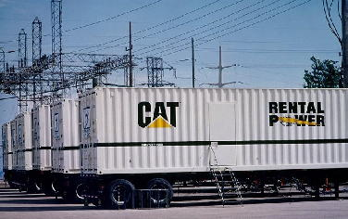
Grid Support: Rental Power Units
Many utilities have been meeting short term needs with diesel engine rental units
Notes:
During the last two summer peak periods, utilities have relied heavily on mobile diesel engine generator “power modules” (TM Caterpillar) These self contained, modular power systems can be installed quickly to shore up utility peak capacity needs. These peak requirements can either be supplementing generation or deferring the need to upgrade substations or other delivery capability. Other, more permanent types of DG systems could be utilized for grid support applications. In addition, gas-fired systems, either permanent or “semi-mobile” could be utilized where environmental concerns preclude expanded use of diesel fuel for power generation.
In the case of substation upgrade deferrals, the economics are as follows: Substation transformers are sized for peak load -- typical peak occurs 200 hours/year or less. Substation transformers cost $100/kVA -- plus $100/kVA for substructure, buswork, protective devices, other costs. A typical substation would require $2-3 million with a 2-year lead time required for an average substation of 10-16 MVA. Because of the lead time required, planners must forecast the substations that will need upgrading in advance -- inaccuracies in forecasting lead to overbuilding or constrained areas. The use of quickly deployed DG facilities can economically defer these investments.
Grid support can also come from customer owned facilities, though there isn’t as yet a well-defined market for quantifying or pricing these benefits and services.

Slide 21
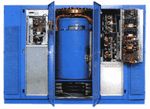
Power Quality Applications
Surepower onsite power generation and delivery system installed at a regional credit card verification center
99.9999% availability
Multiple ONSI 200 kW Fuel cells, Piller flywheel energy storage, and integrated controls
Notes:
Today’s business relies on worldwide communications and computerized information storage and retrieval. Process and fabrication industries are increasingly relying on programmable logic controllers (PLCs). This equipment is very sensitive to voltage and current variations, micro-outages lasting only a fraction of a second, not to mention the very high costs associated with an actual black-out. Communications, banking, internet commerce, semiconductor manufacture and others require power quality and reliability far beyond what the grid can provide. Many of these uninterruptible power systems (UPS) are based on batteries or other electricity storage media. However, most systems incorporate DG either for backup or to operate continuously so as to provide a cleaner power signal than what the grid provides.
The example technology/application shown is a complex system installed by Surepower at a regional credit card center. This center requires 99.9999% reliability. Outage Costs are $13,000/minute. The solution provided by Surepower was redundant ONSI fuel cell modules providing power continuously and using the grid for backup. The UPS requirement of the system is met by flywheel storage systems that allow the system to “ride out” short duration power disturbances.
The growth in these systems is expected to follow the growth in communications, e-commerce, high speed data systems, and computerized production.

Slide 22
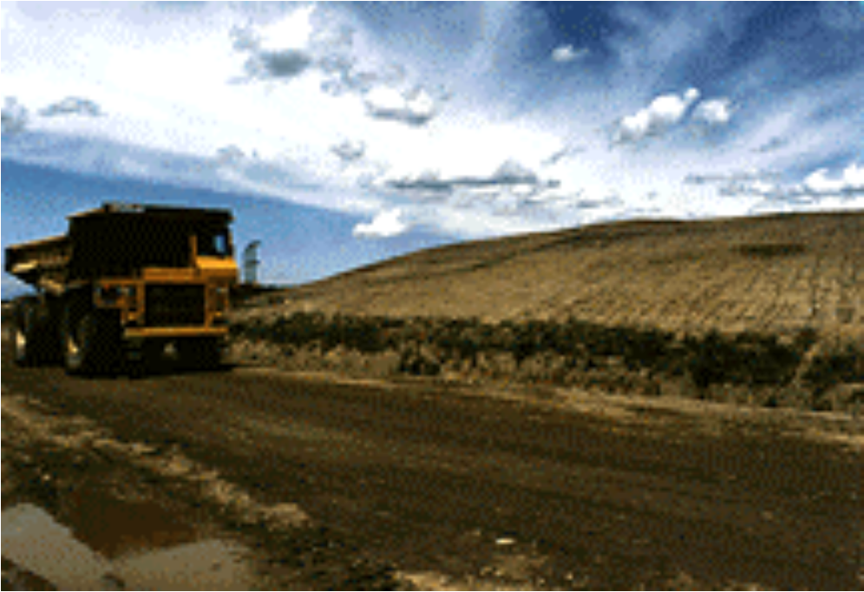
Landfill and Digester Gas Market
105 acre landfill in upstate New York
5.6 MW of power production using methane collected from the landfill
System is grid-connected and all power is sold back to the utility
Notes:
The use of available combustible gaseous fuels from biomass sources at landfills or at sewage treatment plants has been growing at about 15% per year. In many areas, these DG systems benefit from rules that require utilities to purchase their power output and other incentives to encourage the use of renewable fuels. While growing rapidly now, this ultimately a small market overall that will soon reach saturation. Since the fuel is essentially free, high efficiency is not such a priority. Fuel quality is an issue as these fuels may have corrosive contaminants, low energy density, and variable characteristics. Management of these fuel characteristics is an important part of a DG system in this application.
The landfill shown in the picture generates 5.6 MW of power using a methane collection and cleaning system. The system is grid connected and sells power back to the grid. Without this economic system in place, the landfill would be required to collect and flare the gas anyway to minimize the release of methane a gas known to contribute to global warming.

Slide 23
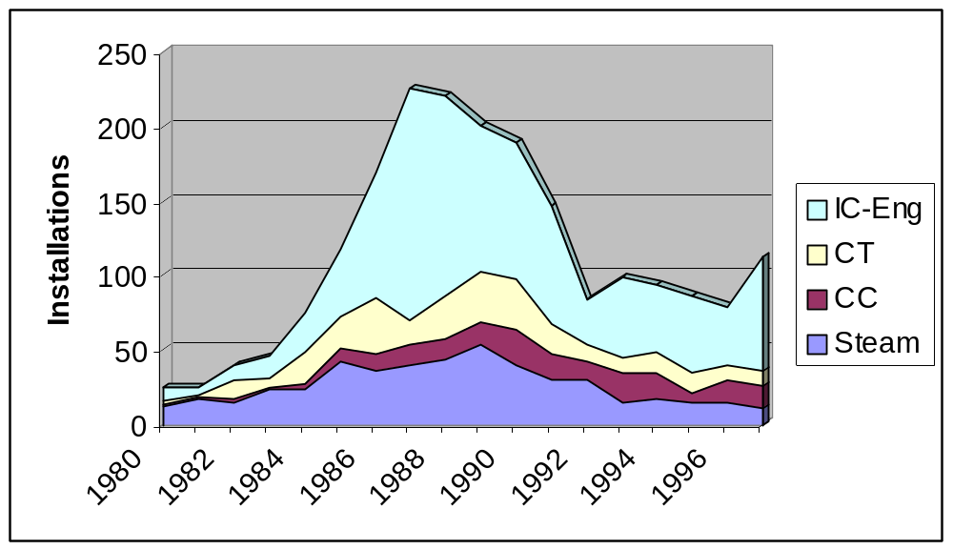
Operating Sites by Year of Initial Operation and Technology
Notes:
This slide shows the breakdown of operating sites by prime mover type and by year of initial operation. In general and especially for packaged IC engine systems, there was a “Golden Age of Cogeneration” from the mid 1980s to the very early 1990s. Number of sites added to the operating list each year went from 25-30 per year in the early 1980s to over 200 per year at the peak of the “Golden Age.” Current levels are averaging 75-100 operating sites added per year. While the overall market additions have stabilized, IC engines are taking an increasing share of total additions.

Slide 24
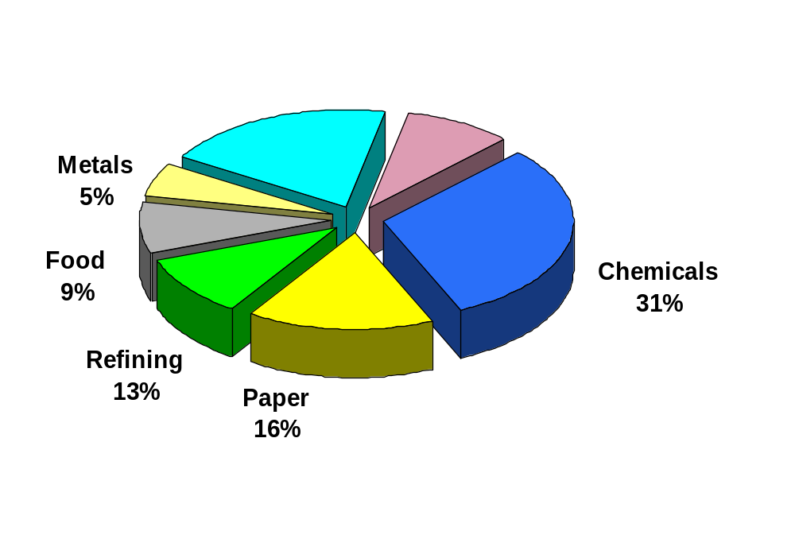
Industrials Represent 90% of Existing CHP
Existing CHP Capacity (1999) 52,800 MW
Other Industrial
20%
Commercial and
Institutional
9%
Source: Hagler Bailly, OSEC

Slide 25
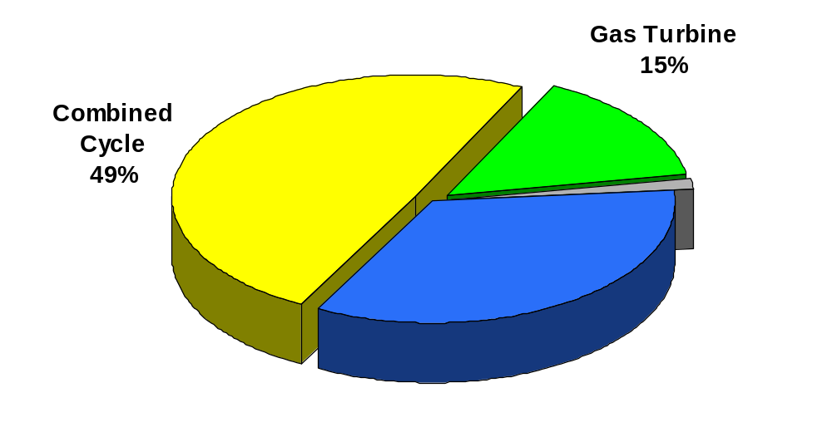
Gas Turbines Dominate Capacity
Existing CHP Capacity: 52.8 GW
Recip Engine
2%
Boiler/ST
34%
Source: Hagler Bailly, OSEC

Slide 26
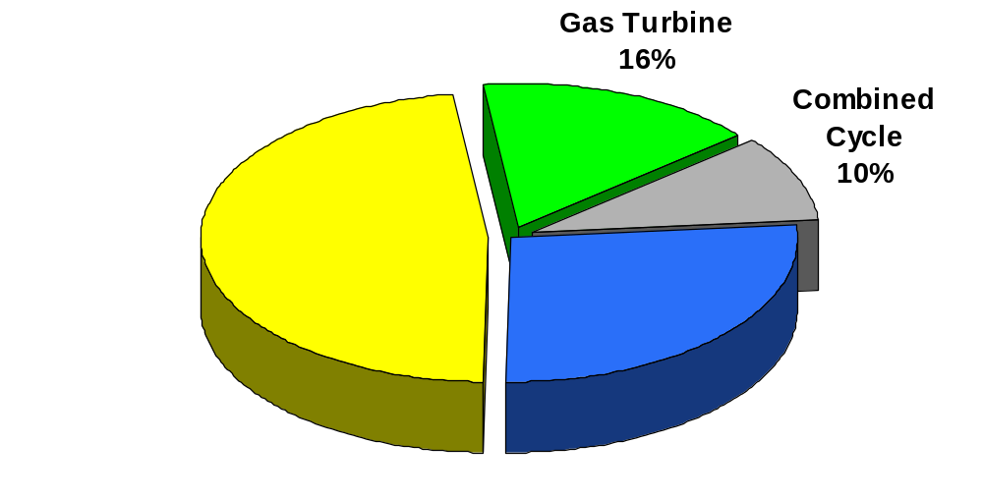
Recip Engines Dominate Sites
Existing CHP Installations: 2167 sites
Recip Engine
48%
Boiler/ST
26%
Source: Hagler Bailly, OSEC

Slide 27
Building an Economic Model
Technology
External
Capacity
Cost
Efficiency
Reliability
Emissions
O&M
Electric Price
Other TOS
Fuel Price and Avail.
Power Reliability
UDCo Attitude
Regulation
$ Agents
Application
Demand
Load Shape
Thermal Demand
Risk Preference
Opp. Cost

Slide 28
Likely Projection for DG Products
Unit Sales
Time
DG will offer a new value proposition in new and unexpected niches. Performance improvements are made, production costs are reduced due to volume, business transactions are more efficient, regulatory changes are made, and DG eventually finds wide market acceptance

Slide 29
Distributed Generation Market Niches
Mechanical drive products to avoid utility barriers
Ultra-premium power to sensitive customers
Standby equipment for missions critical customers
Remote generation in upstream oil & gas installations
Modular generators at substations to defer distribution system upgrades and meet generation reserve requirements
Combined heat and power for industrial and commercial customers
Peak shaving to reduce energy costs
Aggregate standby capacity from onsite emergency generators

Slide 30
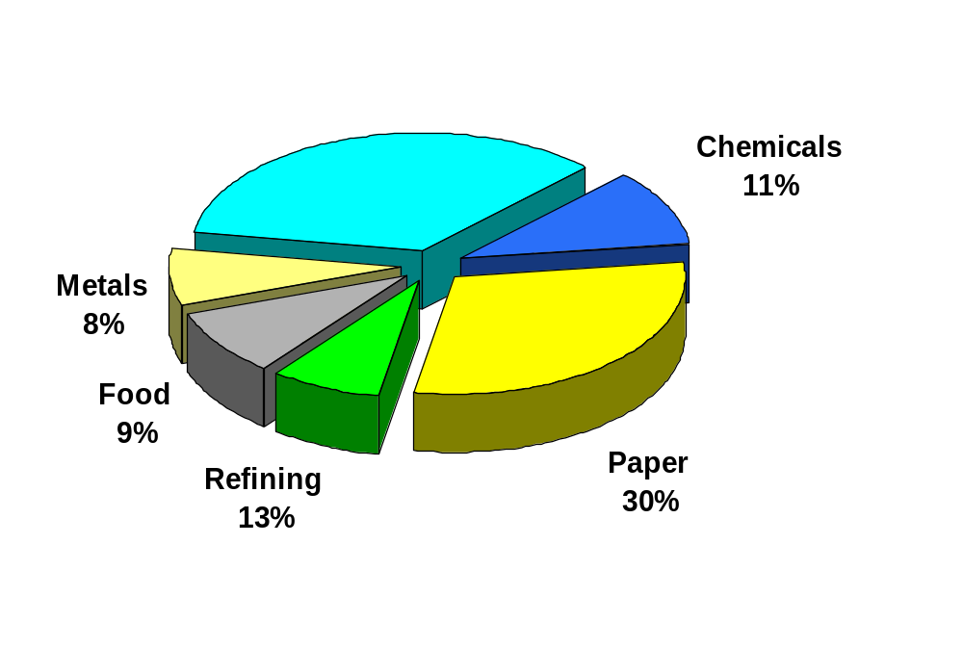
Potential for Additional Industrial CHP
Estimated CHP Potential: 88 GW
Other Industrial
29%
Source:, OSEC

Slide 31
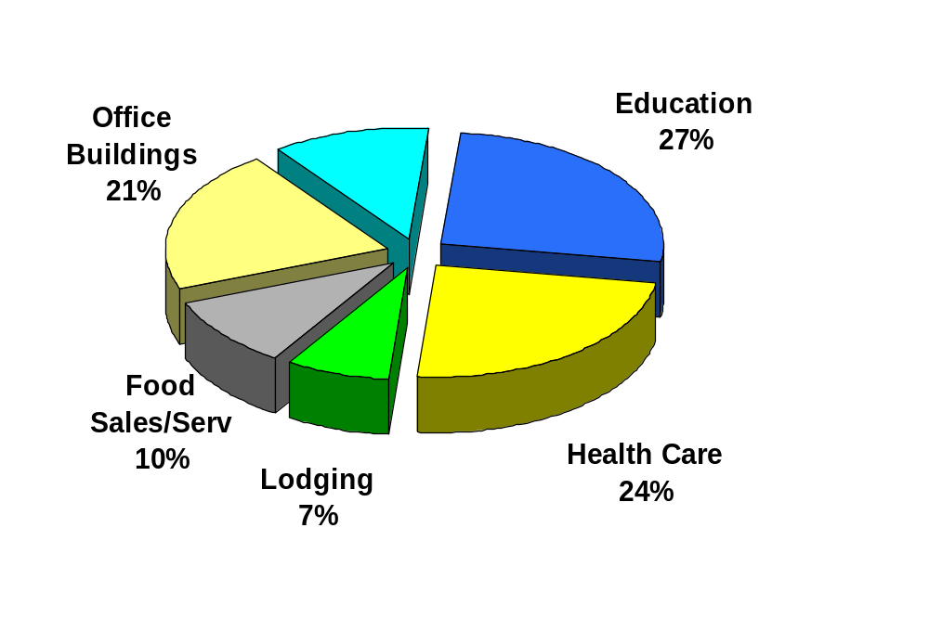
Potential for Additional Commercial CHP
Estimated CHP Potential: 75 GW
Other
11%
Source:, OSEC

Slide 32
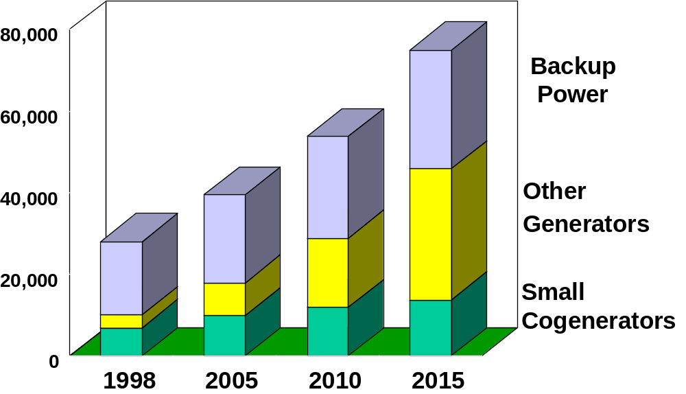
DG Capacity (MW)
Source: GRI Baseline Projection
Notes:
GTI forecasts a fairly rapid growth in DG sized systems. The Figure shows a growth from about 30 GW to nearly 80 GW. This forecast includes back-up power generation, small cogenerators (CHP), and other small generation. Without back-up generation, a category not included in the EIA Annual Outlook, DG is shown to grow from about 10 GW to about 50 GW. This forecast is slightly larger and more rapid than the EIA forecast of 41 GW by 2020.

Slide 33
Barriers to DG?
Deferral rates and practices by utilities
High standby/back-up power costs
Overly strict interconnect requirements and high costs
Stranded Cost recovery on kWh generated
Environmental benefits not recognized
Siting and permitting delays/uncertainties
Non-core customer investment – this may change

Slide 34
Conclusions
Market Conditions and Trends Favor DG
  Technologies
  Economic and Environmental Fundamentals
ESCOs & ESPs Providing Alternative Paths to Market
Federal and State Initiatives Beginning to Recognize DG Benefits and Addressing Barriers
Current Electric Utility Resistance and Regulatory Roadblocks Hinder Widespread Implementation
Niche Markets Evolving Around Specific DG Features
Once Enabling Market Drivers Adequately Evolve, DG Implementation will be Robust

